Slide 1
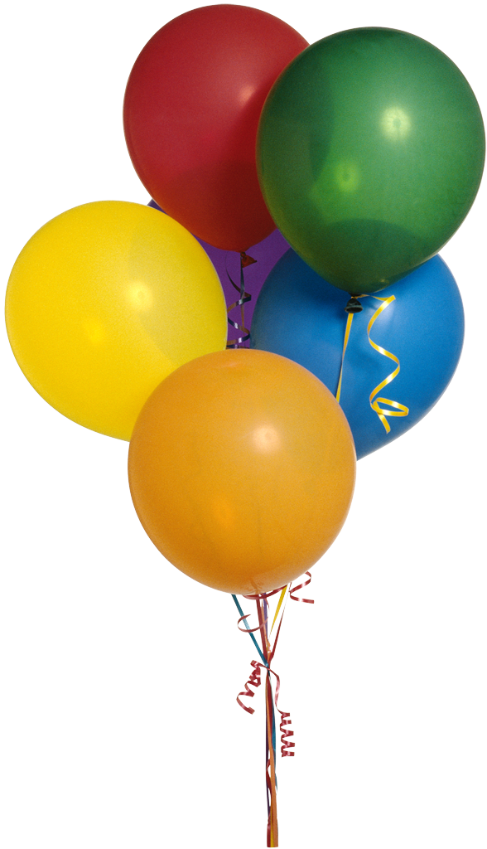
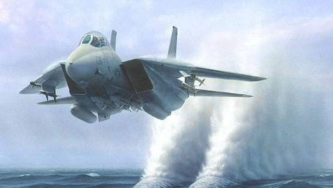
THE PRINCIPLES OF FLIGHT

Slide 2
The Air Around You
The 6 properties of air:
Air takes up space.
Air has weight.
Air can be compressed by applying pressure or squeezing.
Air can insulate.
Air can expand and create pressure when heated.
Air can contract when cooled.

Slide 3
Q: WHAT TYPES OF FEATURES IMPROVE THE DESIGN OF AN EFFECTIVE PARACHUTE?
Notes:
Parachute Adventure! - #sciencegoals:
https://www.youtube.com/watch?v=w4Jgh9V9gwE

Slide 4
Gravity EARTH’s GRAVITY PULLS OBJECTS TOWARD IT’S SURFACE. A PARACHUTES PURPOSE IS TO SLOW DOWN THAT PROCESS. IT DOES SO BY CREATING DRAG. WHAT IS DRAG? ➔ THE PUSH ON SOMETHING FROM AIR OR WATER. THE BIGGER THE SURFACE AREA THE MORE DRAG IS CREATED. A: AN AFFECTIVE PARACHUTE IS VERY LIGHT, HAS A VERY LARGE SURFACE AREA(WHICH CATCHES A LOT OF AIR TO CREATE A LOT OF DRAG MAKING IT SLOW)
Notes:
How Does a Parachute Work? | Mocomi Kids
https://www.youtube.com/watch?v=vZYwsAvHgVw

Slide 5
Q: DESCRIBE THE DESIGN OF A HOT AIR BALLOON AND THE PRINCIPLES BY WHICH ITS RISING AND FALLING ARE CONTROLLED? (HOW DOES IT ASCEND AND DESCEND?)

Slide 6
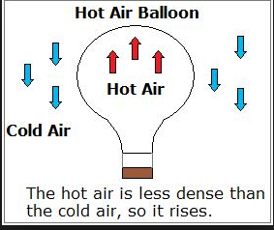
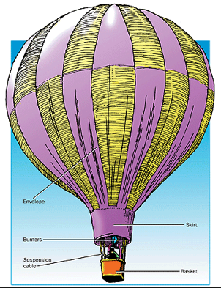
VALVE WARM AIR RISES IN COOL AIR I V

Slide 7
HOT AIR BALLOONS
Q: DESCRIBE THE DESIGN OF A HOT AIR BALLOON AND THE PRINCIPLES BY WHICH ITS RISING AND FALLING ARE CONTROLLED?
(HOW DOES IT ASCEND AND DESCEND?)
A: HOT-AIR BALLONS CREATE LIFT BECAUSE THE BURNER FILLS THE ENVOLOPE WITH HOT, LESS DENSE AIR SO IT BEGINS TO RISE IN THE COOL, MORE DENSE AIR SURROUNDING IT. TO KEEP A HOT-AIR BALLOON ASCENDING YOU NEED TO KEEP PUTTING HOT AIR INTO THE ENVELOPE USING THE BURNER. TO MAKE THE HOT-AIR BALLOON DESCEND YOU MUST RELEASE THE HOT AIR THROUGH THE VALVE AT THE TOP OF THE BALLOON.
How Do Hot Air Balloons Work?
https://www.youtube.com/watch?v=ABsVP41-EeY
Notes:
How Hot Air Balloons Work
https://www.youtube.com/watch?v=77Ej_Ayugxk

Slide 8
WHAT’s THE DIFFERENCE BETWEEN AN AIRPLANE AND A GLIDER? Q: WHAT MAKES A GOOD GLIDER? MAKE GLIDER AS LIGHT AS POSSIBLE MAKE FUSELAGE AS SLIM AS POSSIBLE MAKE IT STABLE, ADD VERTICLE STABILIZERS TO YOUR GLIDER (IT WILL HELP IT FLY STRAIGHT AND KEEP IT STABLE DURING FLIGHT) MAKE IT SYMMETRICAL—MEANING BOTH SIDES ARE IDENTICAL FOLD IT CAREFULLY, CRISP, SHARP EDGES ALLOW GLIDER TO FLY BETTER THAN EDGES FOLDED AND REFOLDED WINGS SHOULD BE SLIGHTLY CURVED SO THAT IT TAKES ON AN AIRFOIL SHAPE. (ALLOWING HIGH PRESSURE AIR TO BUILD UP UNDER THE WING AND GIVES THE PLANE LIFT) GLIDER WITH WINGS THAT HAVE A LARGE SURFACE AREA TAKE LONG SLOW FLIGHTS VS. GLIDERS WITH WINGS THAT HAVE A SMALL SURFACE AREA TAKE SHORTER QUICKER FLIGHTS
Notes:
Flying a Glider
https://www.youtube.com/watch?v=kqawMYEHW2c

Slide 9
YAW, PITCH, AND ROLL…OH MY!!! Q: WHAT ARE ROLL, PITCH, AND YAW? Q:WHAT PARTS OF THE PLANE CONTROL THESE MOVEMENTS?
Notes:
Airplane movements
https://www.youtube.com/watch?v=1JSNZsfrIDg

Slide 10
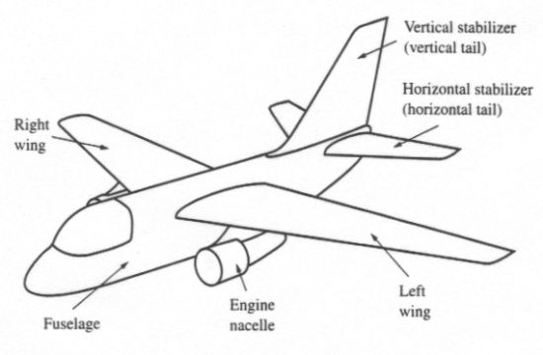
Basic Parts of an Airplane

Slide 11
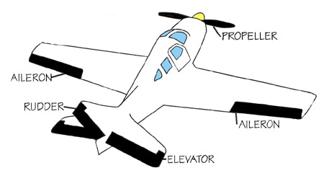
Control Surfaces on an Airplane

Slide 12
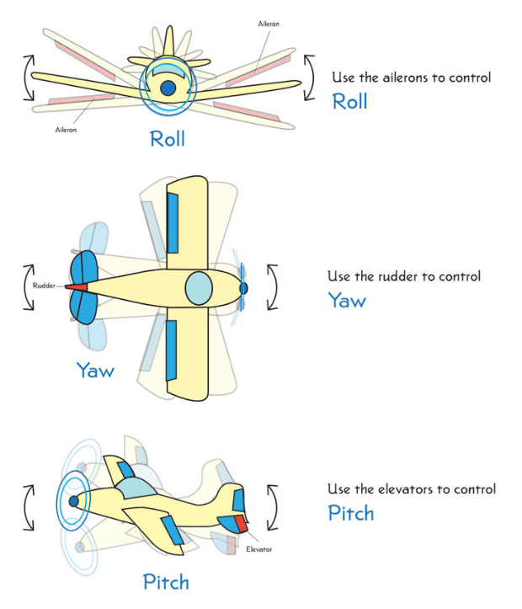

Slide 13
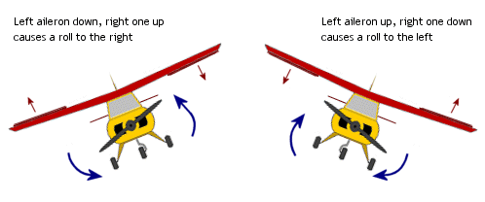
Ailerons Control the Roll

Slide 14
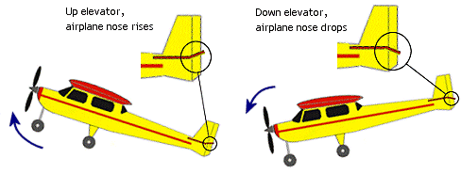
Elevators Control the Pitch

Slide 15
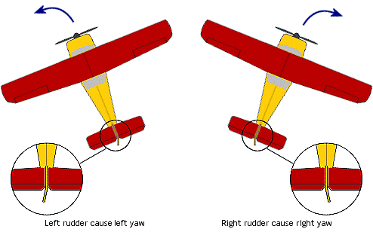
The Rudder Controls the Yaw

Slide 16
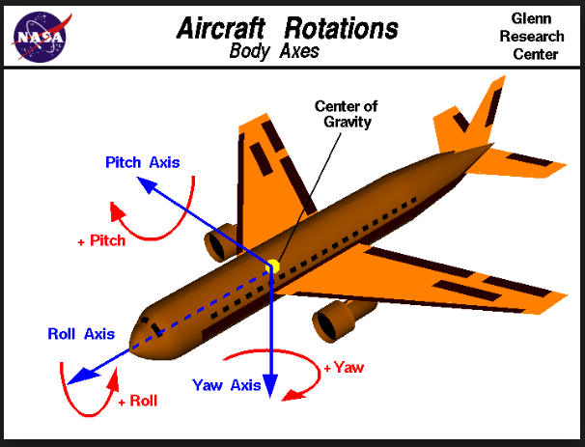
Roll, Pitch and Yaw

Slide 17
PROPELLERS
There are two ways an aircraft can get thrust: A jet engine or PROPELLERS
Propellers are twisted wings that spin like powerful household fans. Propellers are shaped like airfoils which creates high air pressure and low air pressure areas which causes lift. These propellers cause a lift the moves the aircraft up and down instead of titling wings like on an airplane.
Propellers used on planes usually have six long thin blades attached to an engine. They push air backwards forcing the airplane to move forwards causing the wings to cut into the air CREATING LIFT!
A Jet Engine gets thrust by burning fuel. The fuel mixes with oxygen from the air and lights up a spot in the engine. The exhaust gases are forced backwards really fast which pushes the plane forward.
Notes:
How does a Helicopter Work
https://www.youtube.com/watch?v=dTS5cY3XYZw

Slide 18
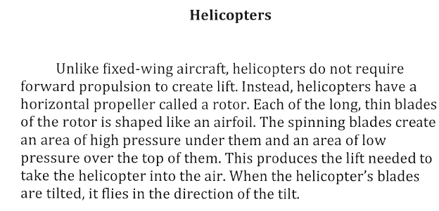

Slide 19
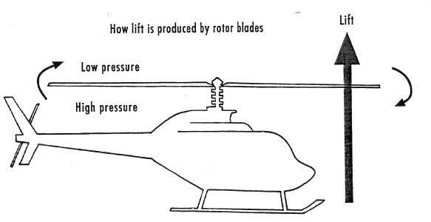

Slide 20
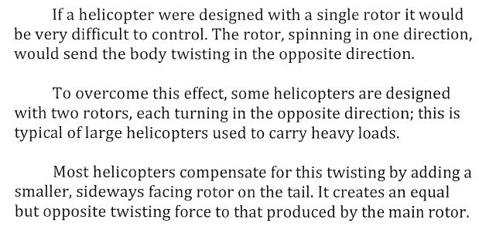

Slide 21
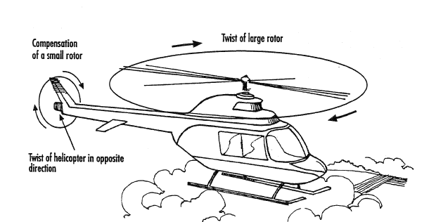

Slide 22
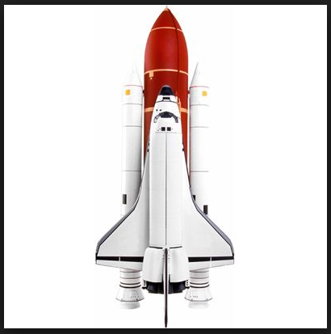
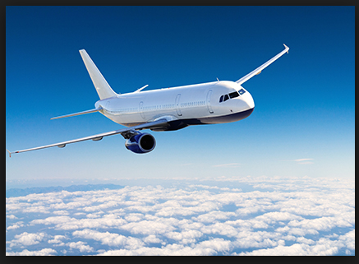
Aircraft vs Spacecraft
THERE IS NO AIR IN SPACE!
Q: What’s the difference between an aircraft and a spacecraft?
Aircrafts get lift once the plane is moving forward. Spacecrafts get lift using rocket boosters and powerful engines that propel them UP not forward.
Aircrafts and spacecrafts achieve thrust the same way: using jet engines. However, because there is no air in space spacecrafts have to carry their own supply of fuel AND OXYGEN.
Spacecrafts have thrusters on them to move forward and side to side in space.
Notes:
Big Construction: space rocket.
https://www.youtube.com/watch?v=2R8V68viXqk

