Slide 1
AIR AND AERODYNAMICS
Air has many properties. It is made up of gases, takes up space, has mass(weight), exerts pressure, living things need it to survive.

Slide 2
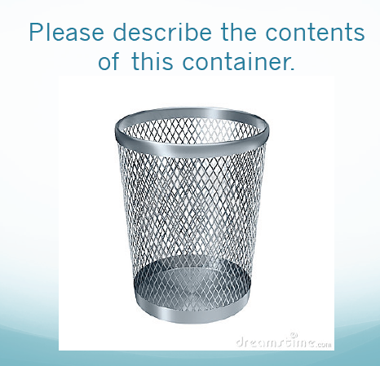

Slide 5
AIR TAKES UP SPACE
Think of Basketballs, footballs, rugby balls, and balloons. Air takes up space giving these objects shape.
Usually you can tell how much space air is taking up by the shape of an object. Example: blowing up a balloon, the space air is taking up changes as the balloon expands.
Experiment: Air is everywhere.

Slide 8
EXPERIMENTS
Three station labs.
Balloon Bottle
Paper cup
Ping Pong ball

Slide 9
UNDER PRESSURE
Air exerts pressure
How do some objects hold their shape then? Let’s think about the balloon again, the air outside of the balloon is exerting the same amount of pressure that the air inside is. Therefore, allowing the balloon to keep a constant shape. If the pressure was not balanced then the balloon would burst.
Atmospheric Pressure: Earth’s gravity pulling on air towards EARTH. This puts pressure on your body.
Why don’t humans get crushed from atmospheric pressure? We are designed to handle the pressure and WE HAVE AIR INSIDE US to balance the pressure.
https://www.youtube.com/watch?v=QeAp3CuGjk8

Slide 13
AIR PRESSURE
-YouTube: F-14 breaking the sound barrier (00:21) -YouTube: Sonic Boom (02:31) -YouTube: https://www.youtube.com/watch?v=jZ3Hhdr8EjI
YouTube: https://www.youtube.com/watch?v=tFZ_ncX3-mY

Slide 15
Question
How does blowing air affect air pressure?

Slide 16
Hypothesis
What is a hypothesis?
I think that if we blow air towards the can then the candle will ____________(stay lit or go out) because________________________.

Slide 17
Diagram

Slide 18
Results
The candle did not stay lit

Slide 20
Inferences
Air is fluid, so it travels around the can to blow out the candle
A fluid: is a substance that flows and takes on the shape of its container
When air moves faster it has less air pressure
The regular air pressure of the room forces the fast moving air around the can

Slide 21
Air is so Massive and Dense (Mass and Density)
Mass refers to the amount of matter in an object
Density refers to how tightly or how loosely packed the molecules of an object are.
Density= mass/volume
Take two bottles of the exact same size. One is filled with water and the other with air. We know that the bottle filled with air is heavier, that is because water is more dense then air. Water’s molecules are closer together than air’s.
Two balloons are attached to a straw, one at each end. One is filled with air the other is not. What would happen to the straw? Which balloon would be heavier?
What happens to air at sea level? How much pressure is air exerting? What about at the top of a mountain? How much pressure is air exerting there?

Slide 25
Air is a Fluid
Air can expand, contract, or be compressed.
Air is a fluid. Fluids are gases or liquids.
The molecules in fluids are not fixed (they can MOVE AROUND and SLIDE PAST EACH OTHER)
Fluids take the shape of whatever the a poured/put in to.
Fluids flow from areas of high pressure to areas of low pressure.
Pressure or temperature changes in fluids lead to density changes
The warmer it is the further apart the molecules get (expand) making air less dense, the colder it gets the closer the molecules (contract) the more dense air becomes
Warm air rises because it is less dense then cold air

Slide 28
Compressed Air
Air can be compressed (SQUISHED) into smaller spaces by forcing the molecules closer together than normal.
Molecules that make up gases are far apart so they can be compressed using pressure.
Some examples: Aerosol Spray cans (hairspray), soccer balls, basketballs, bike tires, scuba tanks, power tools.

Slide 31
BERnoulli’s principle
AS THE SPEED OF A MOVING FLUID INCREASES THE PRESSURE WITHIN THE FLUID DECREASES
The wing of an airplane is shaped like an airfoil. It is designed like this so that air flows over the top of the wing faster than it flows under the wing.
Air pressure on the top of the wing would be lower and under the wing would be significantly higher causing a push on the wing upwards…CREATING LIFT!

Slide 34
Flight and Streamlining Basics

Slide 35
Important Vocabulary
Accelerate: Go faster
Decelerate: Slow down
Ascend: Go up
Descend: Go down
Propulsion: What gives an object the force to move forward
Adaptation: A device or mechanism that changes to become suitable to a new situation

Slide 36
Forces oF flight
LIFT: An upward force on an object (it’s what keeps a plane flying)
THRUST: A force on an object that gives them a forward motion. (Propellers/engines on an airplane)
DRAG: A force that acts to slow down an object as it moves. (Putting your hand out the window of your car vertically VS putting your hand out the window horizontally)
Gravity: A downward force pulling an object to the ground. The heavier/more mass an object has the bigger the gravitational pull. (Airplanes are made of light weight materials)
Lift and gravity oppose each other
Thrust and drag oppose each other
https://www.brainpop.com/technology/transportation/flight/

Slide 37
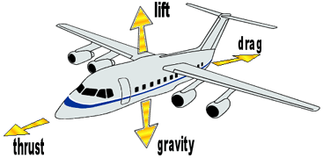
Four Forces of Flight

Slide 38
The following four forces affect flying objects, such as aircraft, birds, and insects, while they are in flight.
Lift: The upward force that keeps a flying object in the air. Airplanes get lift from their wings.
Thrust: The force that gives an object a forward motion. The engines in an aircraft give it the thrust needed for flight.
Drag: The force that acts to slow down an object as it moves through the air. Today, airplanes and other vehicles are often designed with smooth lines to cut through the air and overcome drag.
Gravity/Weight: The force that pulls objects down towards the ground. The more mass an object has, the greater the gravitational pull on the object.

Slide 39
In a flying airplane…
If lift becomes greater than the weight, the plane ascends (goes up)
If thrust becomes greater than the drag, the plane accelerates (goes faster)
If lift, weight, thrust and drag become equal, the plane would hover - maintain the same speed and altitude (height)
If thrust becomes less than drag, the plane would decelerate (slow down)
If lift becomes less than weight, the plane descends (goes down)

Slide 40
Birds
Birds have adaptations that allow them to fly:
Feathers: This allows them to be more aerodynamic and tail feathers help them steer.
Powerful Muscles: The are built to sustain the repetition and power needed for flight.
Air Sacs: Located in the thorax and abdomen give the bird enough oxygen for flight
Hollow Bones: Makes the bird light weight
Wings: Allows the birds to achieve lift. They are curved at the top and flat on the bottom.

Slide 41
BIRDS
Skeletal: https://www.youtube.com/watch?v=11fZS_B6UW4
Feathers: https://www.youtube.com/watch?v=Y2yeNoDCcBg
Muscles: https://www.youtube.com/watch?v=aFdvkopOmw0
https://www.youtube.com/watch?v=L-e5RzF8tcg

Slide 42
Adaptations That Allow Birds to Fly
Some birds such as hawks, are able to soar.
Other birds, like geese, have adapted so they can fly long distances.
Birds, such as hummingbirds, are able to fly swiftly.
Some adaptations in birds include:
Feathers, powerful flight muscles, air sacs, hollow bones, and the shape of their wings.

Slide 43
More About Birds
Skeleton:
Bones are hollow or partially hollow, making them light but strong.
Muscles:
Large pectoral muscles that generate the power to flap the wings.
Muscles do not tire quickly.
Breathing System:
Lungs are connected to a network of air sacks that fill up with air, helping to provide the body with a large amount of oxygen used during flights.

Slide 44
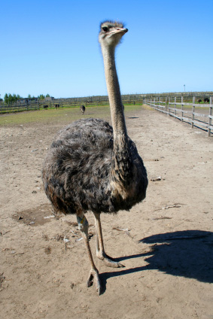
Why Can’t Ostriches Fly?
Ostriches have evolved to live on land.
Likely descended from birds who could fly, however they have lost this ability over time as they adapted to life on land.
Ostriches have large bodies with solid, heavy bones. Their bodies are not designed to be able to overcome their weight to gain lift, and as a result, they are not able to fly.

Slide 45
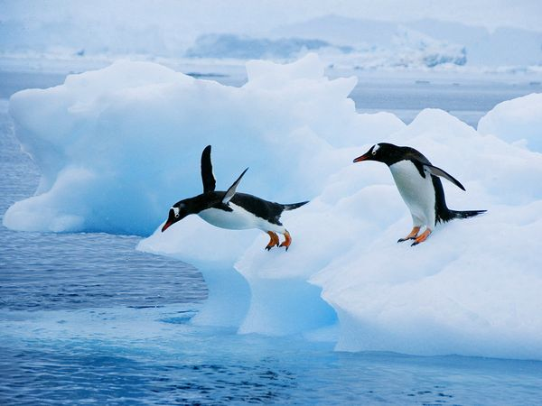
Why Can’t Penguins Fly?
Although they are not able to fly in the air, penguins have streamlined bodies and are well adapted to an aquatic lifestyle.
Likely descended from birds who could fly, however they have lost this ability over time as they adapted to life under water.
Penguins use their wings to move through the water. They appear to fly under the water.
Penguins have solid, heavy bones, which helps them to dive under the water.

Slide 46
Insects
Wings (sometimes tow pairs of wings that overlap): made up of a thin membrane and have veins that run throughout. These veins supply extra support for the wings. There are no bones or muscle in insect wings.
Large insects flap their wings up and down while smaller insects flap their wings in a figure 8 motion
An insect’s muscles for flight are found in the thorax. Since they are cold blooded insects can’t fly until they are warm. As the weather changes and it gets colder insects are not able to warm themselves enough for flight.

Slide 47
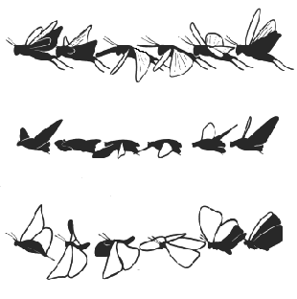
Insect Adaptations for Flight
Some adaptations of insects include:
Wings are made from a thin membrane that contains many veins, which give the wing structure and support.
Airfoil shaped wing.
Most insects have wings that are made of two parts.
Large bodied insects flap their wings rapidly in a figure eight formation.
Specially designed flight muscles. Insects are warm-blooded, so they must warm their flight muscles to gain enough power for flight. They are not able to gain flight in cold weather.

Slide 48
Propulsion
Propulsion gives an object the force to move forward.
Propulsion is need for thrust
Birds and insects use their wings
Airplanes use jet engines or propellers

Slide 49
Means of Propulsion For Flying Animals and Aircraft
Thrust is the act of an object moving forward, and propulsion is what gives the object force to move forward.
Propulsion for flying animals is generated by the flapping of their wings.
Propulsion for aircraft is generated by either propellers or a jet engine.

Slide 50
How Streamlining Reduces Drag
Imagine that you drop a flat piece of paper and a crumpled piece of paper from the same height. Which would hit the ground first and why?
The crumpled piece of paper hits the floor first because of the difference in the amount of friction (drag) between the paper and and the particles of air.
The crumpled piece of paper has less surface area. There is less drag because fewer air particles have to be pushed aside as the paper falls.
The flat sheet does not fall flat side down because it slips through the air at an angle. This causes the flat sheet to move in a back and forth angle.

Slide 51
Questions to Consider
What is streamlining?
What are some everyday examples of how people use streamlining to cut through the air?
What are some examples of streamlining in nature?

Slide 52
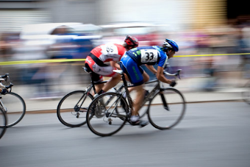
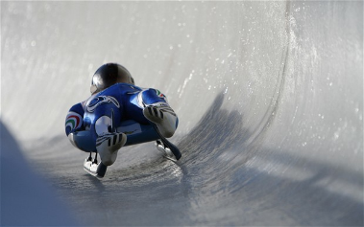
Examples of How People Use Streamlining
Car designs
Racing bicycles
Downhill ski racers
Bobsledding
Aircraft
Speed boats

Slide 53
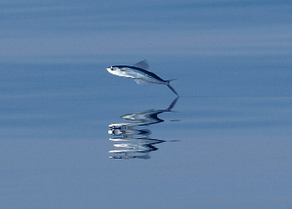
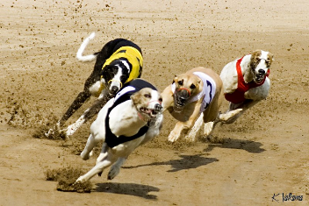
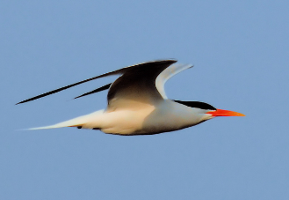
Examples of Streamlining in Nature
Birds
Flying fish
Racing dogs such as greyhounds

Slide 54
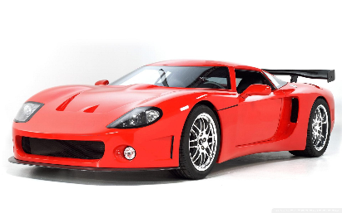
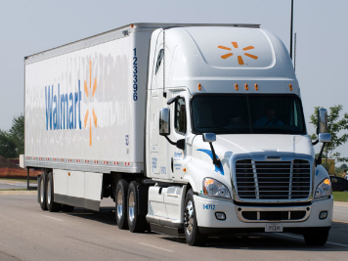
Vehicles and Streamlining
The faster a car goes, the harder it is hit by air. The air holds it back. If a car has large panels, there is greater air resistance. If the car has a smooth aerodynamic design, it has less air resistance and requires less power to cut through the air.
Sports Car = Less Drag Semi = More Drag

Slide 55
Streamlining
MAKE SOMETHING AERODYNAMIC SO THAT IT DOES NOT CREATE DRAG or reduces drag.
If you took two pieces of paper and crumpled only one which one would hit the ground first?
The nose of a plane is pointed, smooth, and round so that it doesn’t create drag, it allows air to flow easily over it.

Slide 56
STREAMLINING
The faster a car goes, the harder it is hit by air. The air holds it back. If a car has large panels, there is a greater air resistance. If the car has a smooth aerodynamic design, it has less air resistance and requires less power to cut through the air.

Slide 57
Examples of how people use streamlining include:
Car Designs
Racing Bicycles
Downhill Ski Racers
Bobsled racing
Aircraft
Speed Boats
Examples of streamlining in Nature
Birds
Flying Fish
Racing Dogs such as Greyhounds

Slide 58
Gas
Air is a mixture of gases like nitrogen, oxygen, and argon.
There are traces of water, and carbon dioxide
Oxygen is needed for combustion, oxidization, burning. (peeled apples browns from the air, candle in an enclosed case will only burn till there isn’t any oxygen left)
Carbon dioxide is heavier then most gases and therefore sinks. It can be used to extinguish flames.

